Slide 1
Module 2.2 and 2.3 FM generation and detection

Slide 2
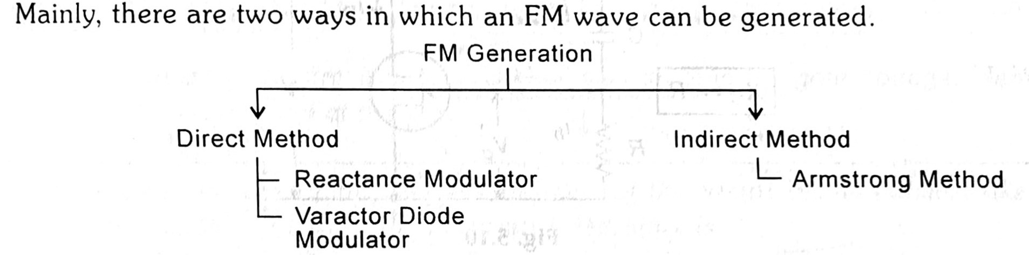

Slide 3
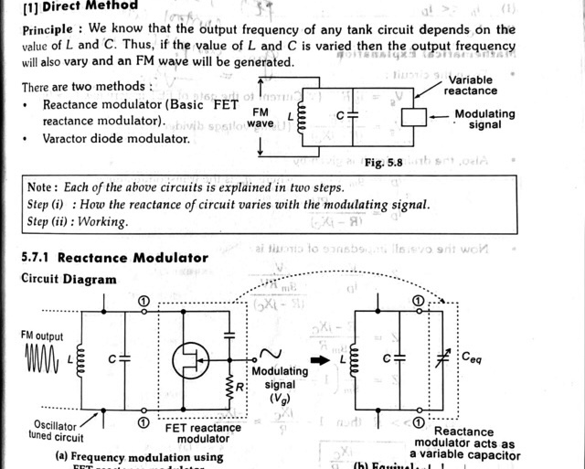

Slide 4
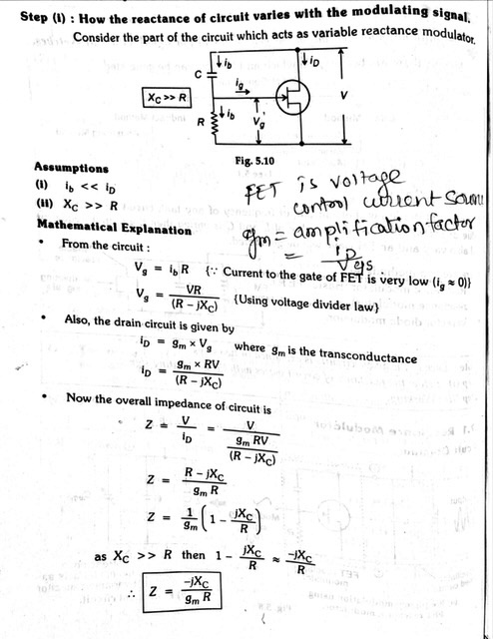

Slide 5
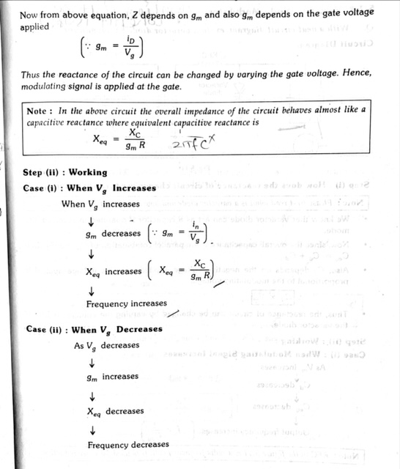

Slide 6
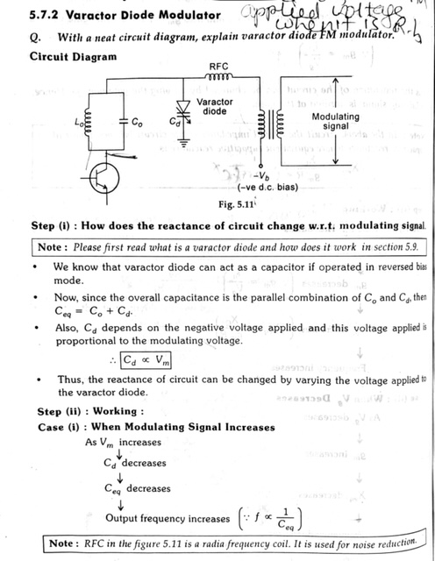

Slide 7
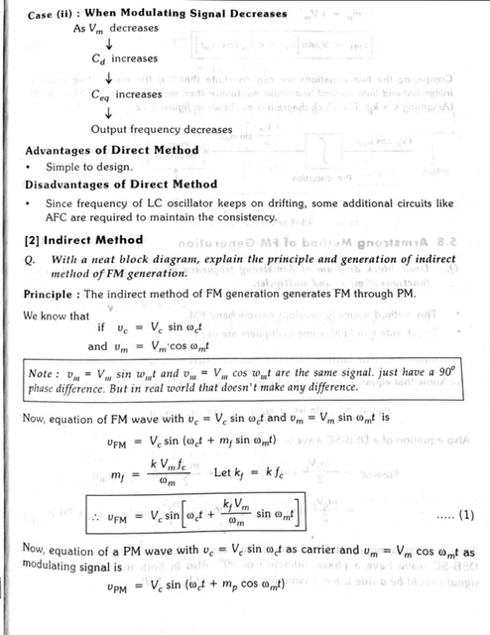

Slide 8
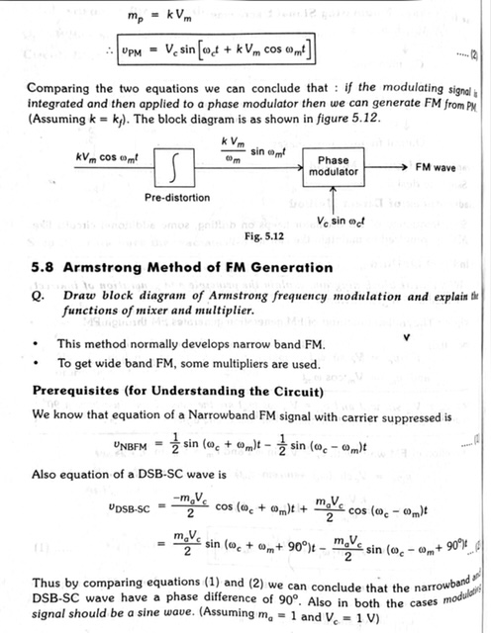

Slide 9
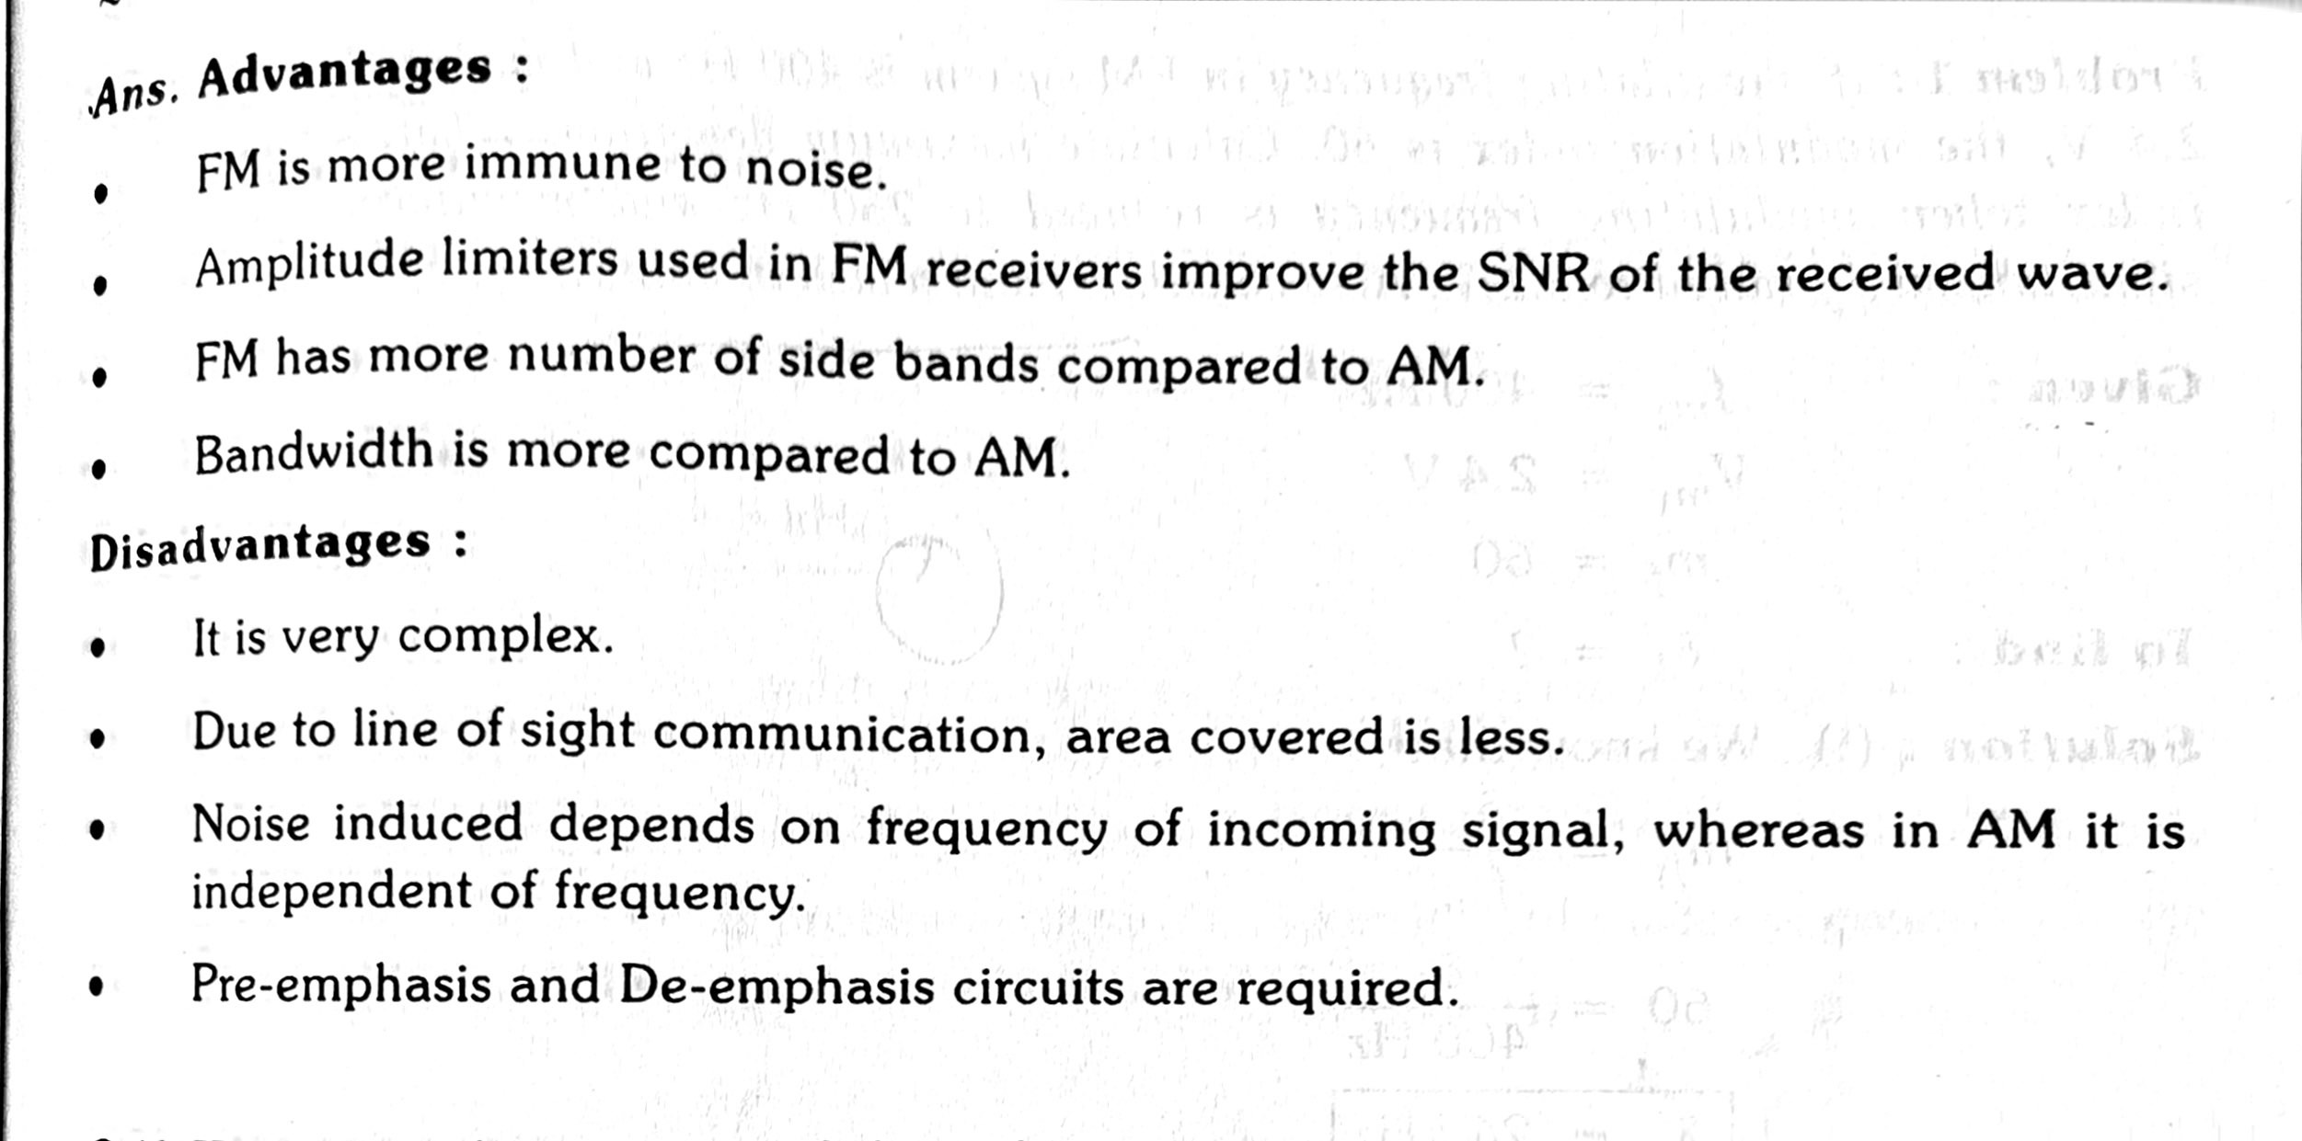

Slide 10
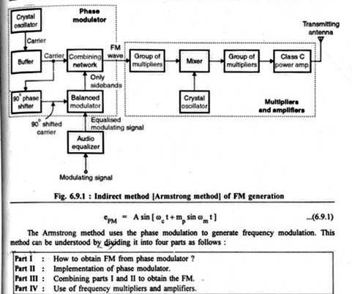
Indirect Method of FM Generation

Slide 11
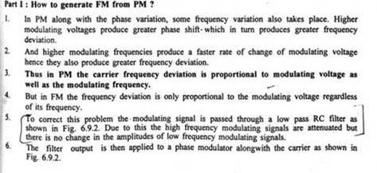

Slide 12
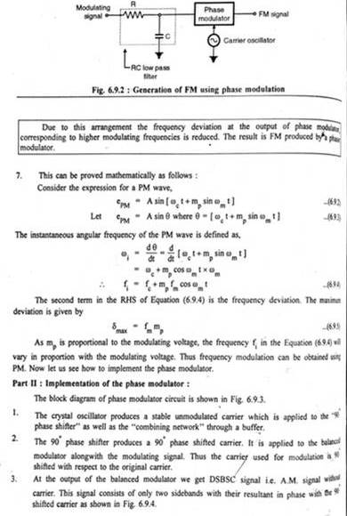

Slide 13
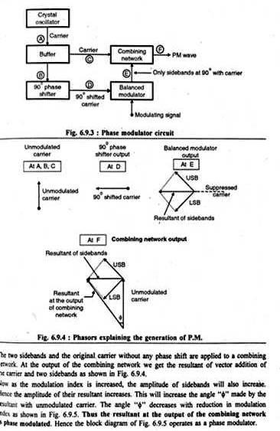

Slide 14
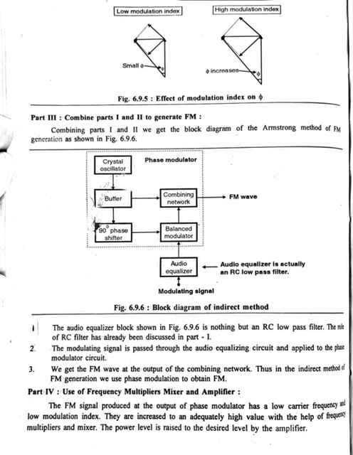

Slide 15
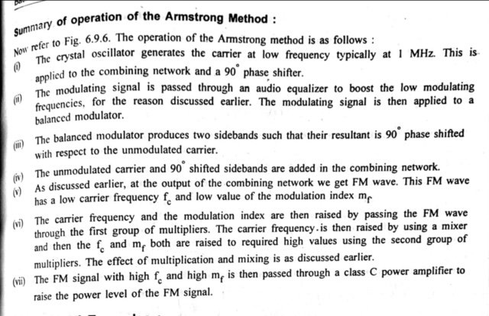

Slide 16
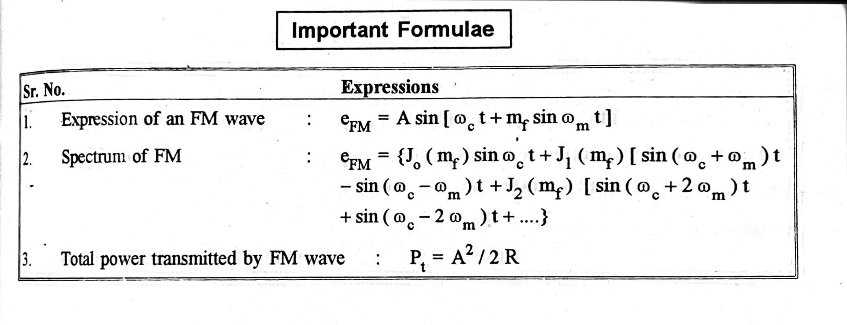

Slide 17
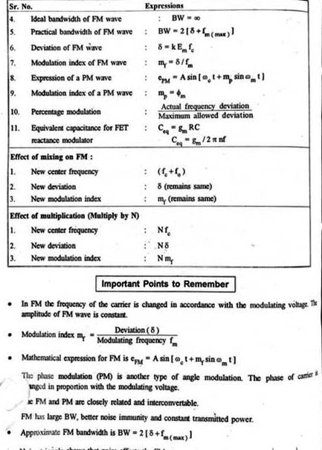

Slide 18
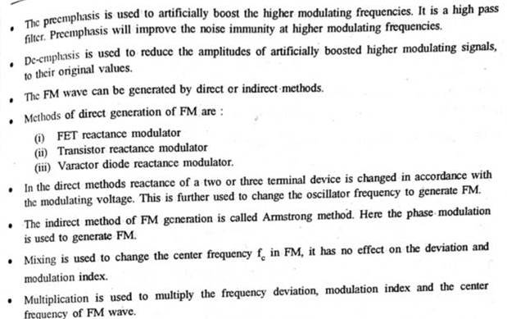

Slide 19
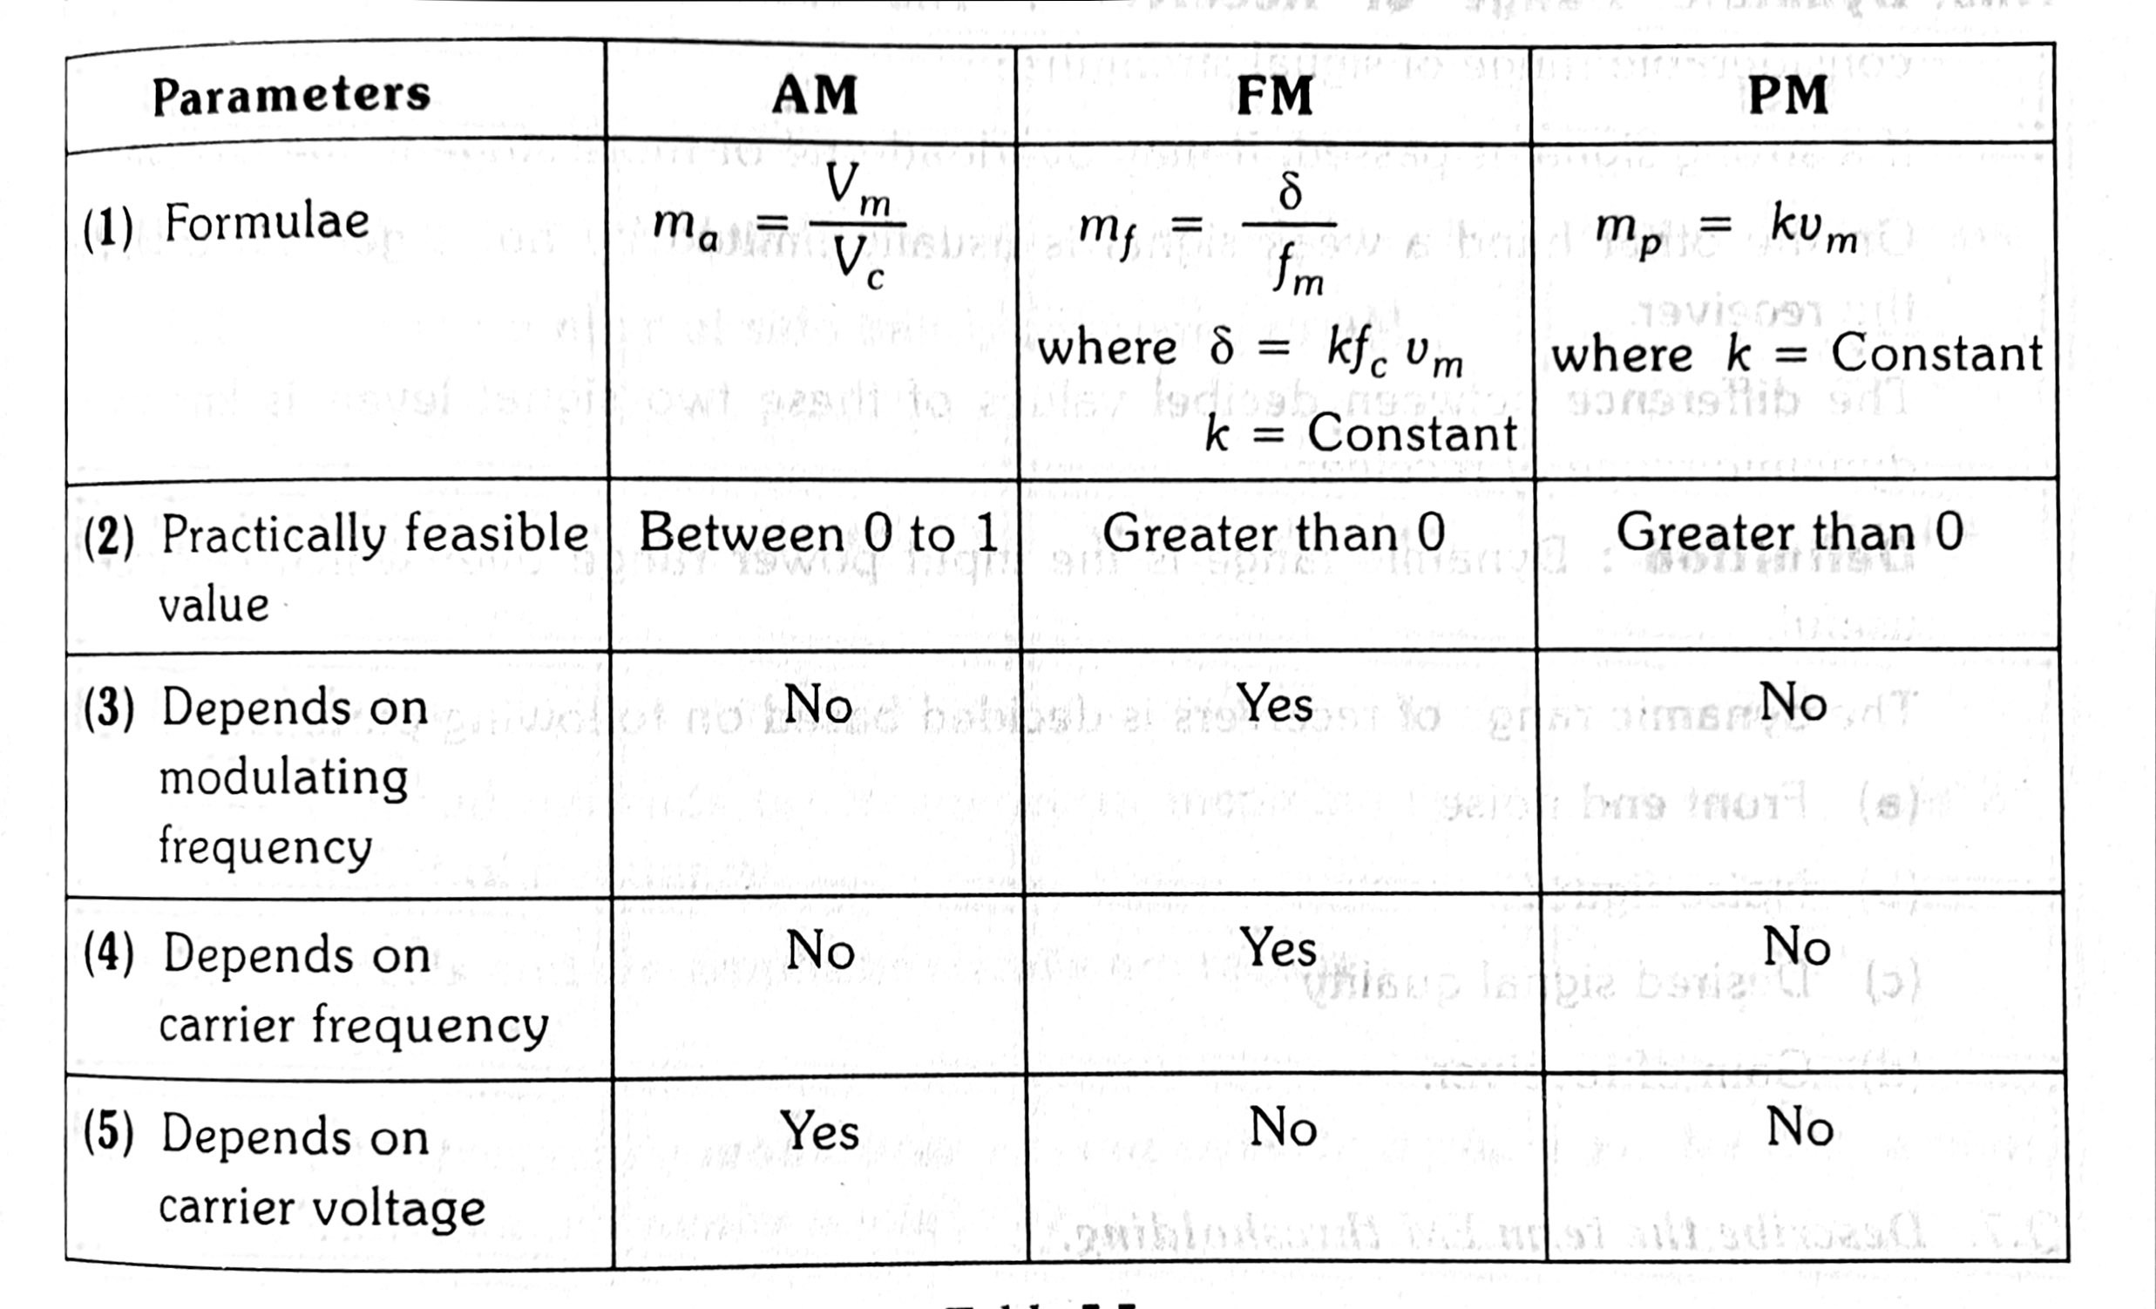

Slide 20
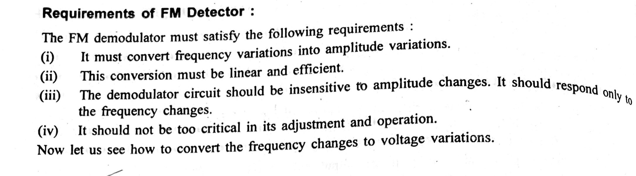
FM Demodulator

Slide 21
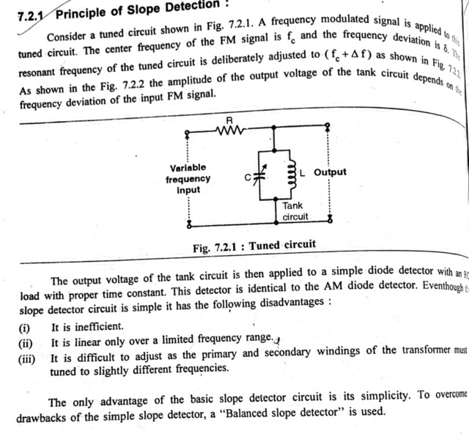

Slide 22
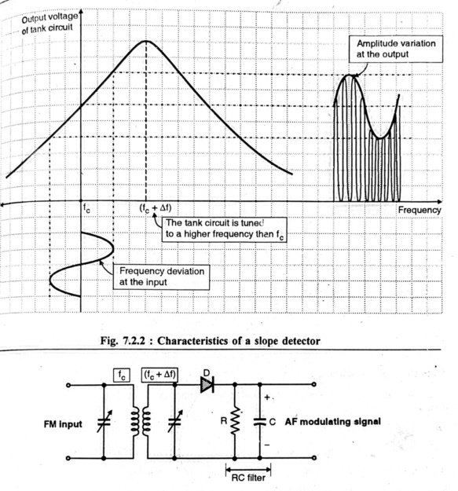

Slide 23
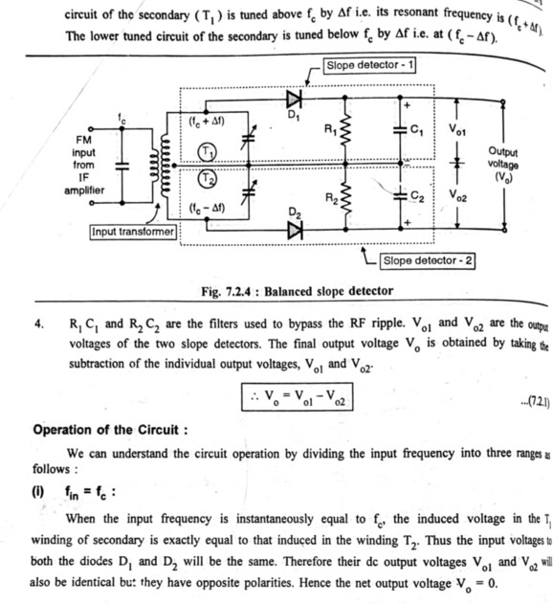

Slide 24
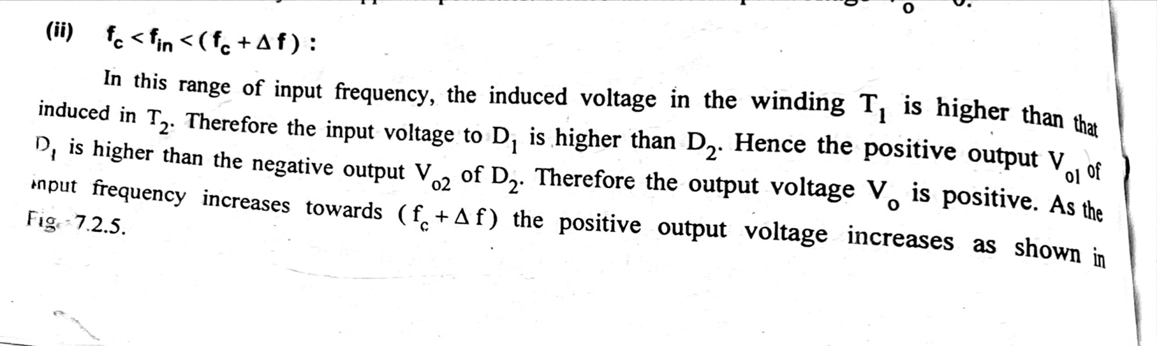
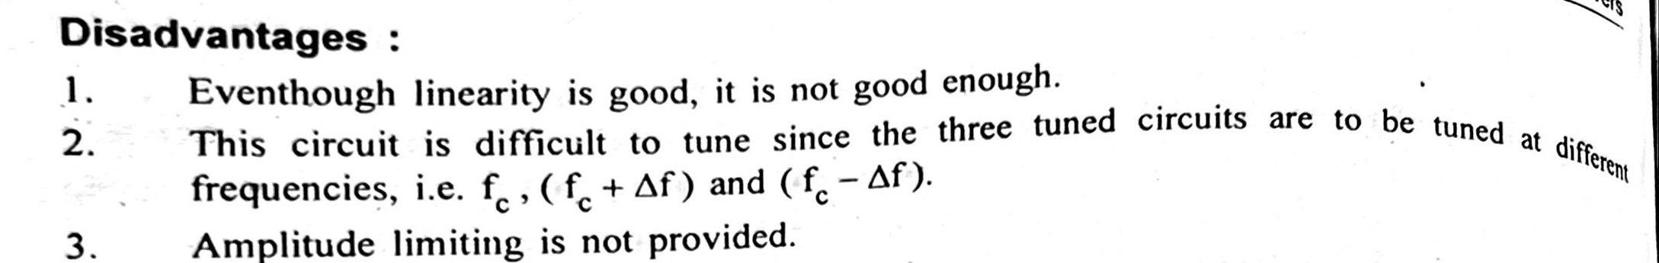

Slide 26
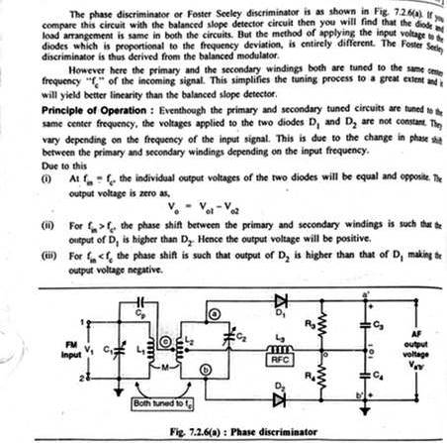
Phase Discriminator [Foster Seeley Discriminator

Slide 27
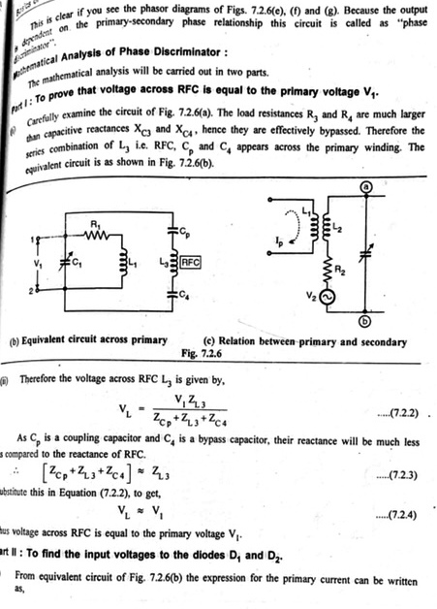

Slide 28
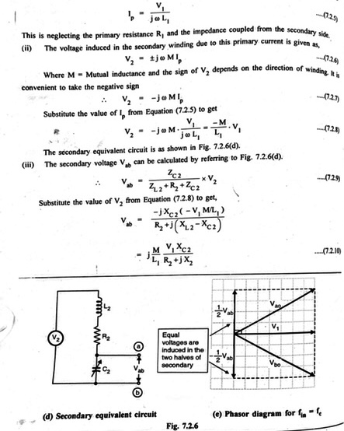

Slide 29
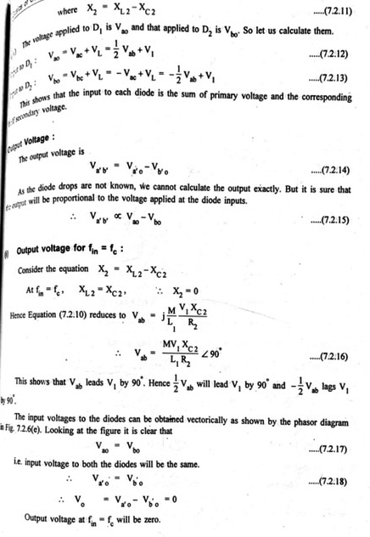

Slide 30
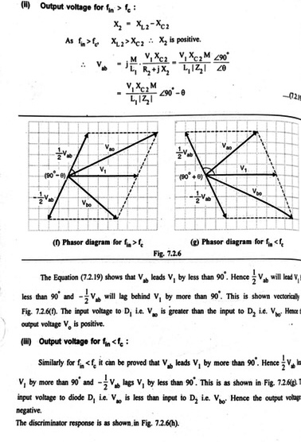

Slide 31
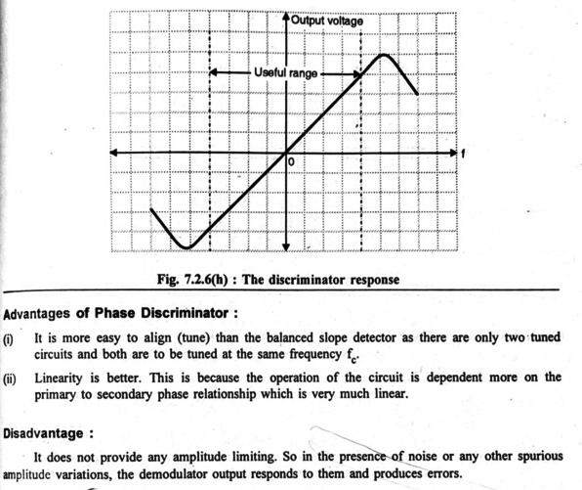

Slide 32
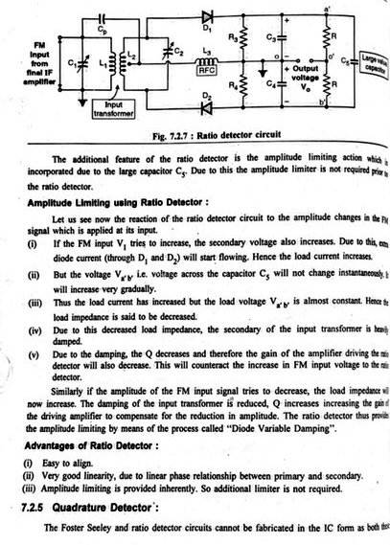

Slide 33
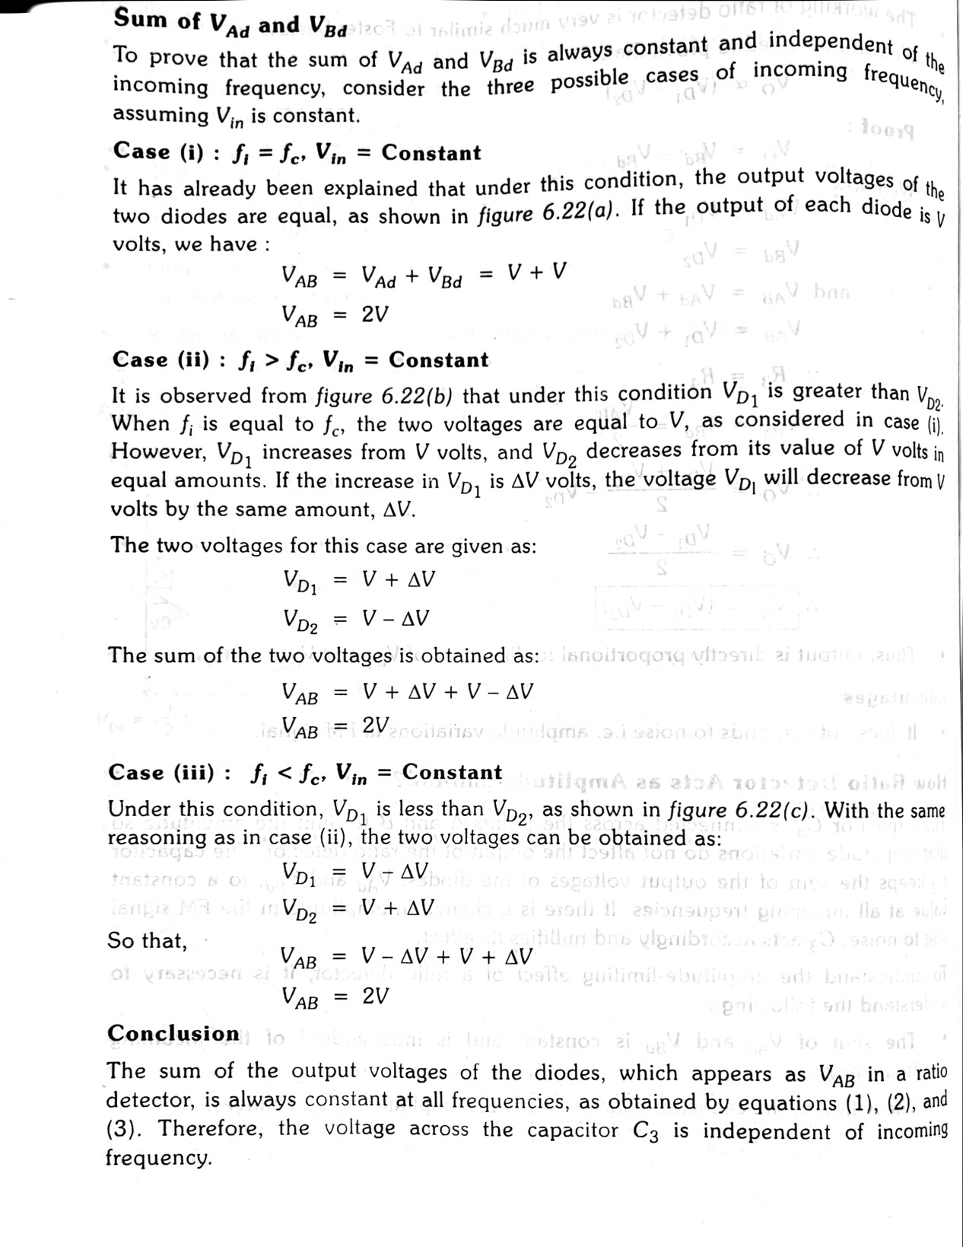

Slide 34
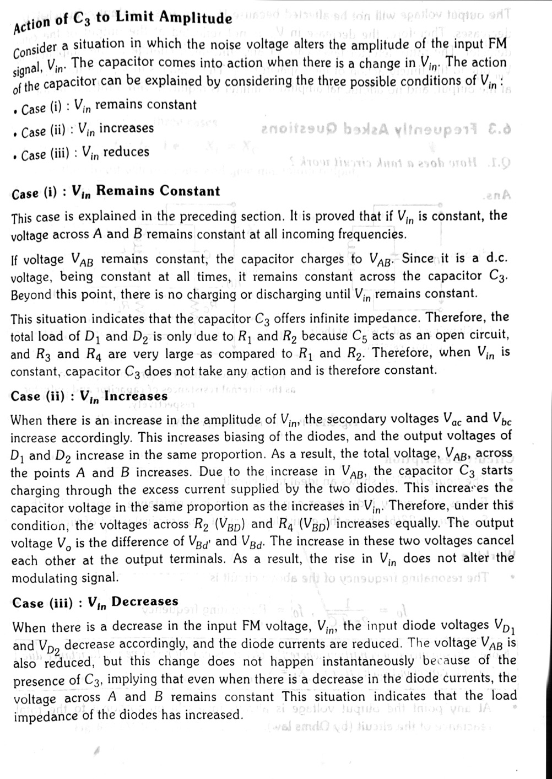

Slide 35
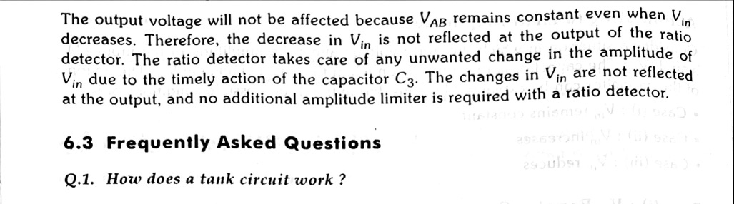

Slide 36
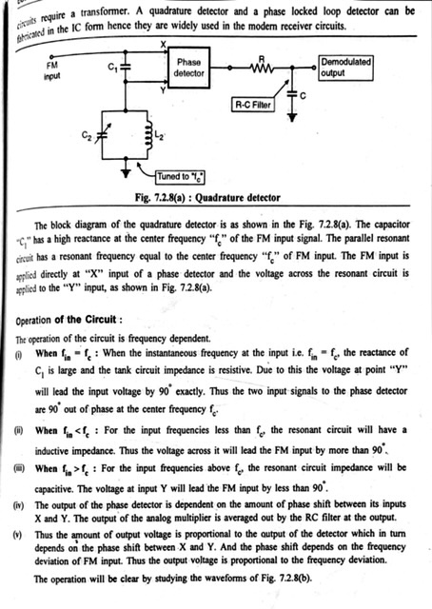

Slide 37
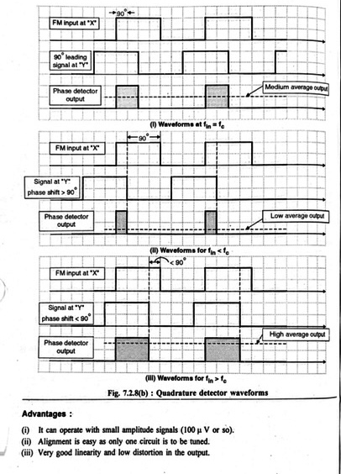

Slide 38
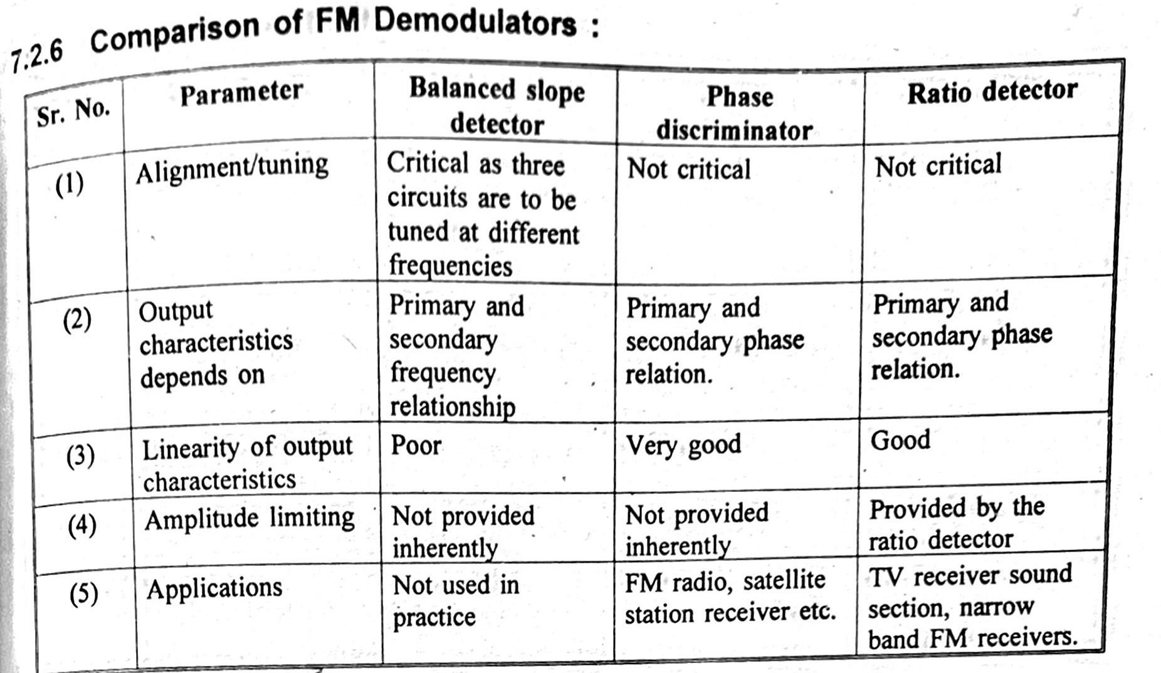

Slide 39
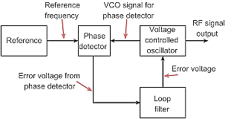
FM detection using Phase lock loop
A Phase-Locked Loop (PLL) is basically a negative feedback system.
A VCO is a sine wave generator whose frequency is determined by the voltage applied to it from an external source. It means that any frequency modulator can work as a VCO.
A phase-locked loop (PLL) is primarily used in tracking the phase and frequency of the carrier component of an incoming FM signal.
application in commercial FM receivers.

Slide 40
Working Operation
The operation of a PLL is similar to any other feedback system where the feedback signal tends to follow the input signal.
If the signal fed back is not equal to the input signal, the error signal will change the value of the fed back signal until it is equal to the input signal.
The difference signal between s(t) and b(t) is called an error signal.
A PLL operates on a similar principle except for the fact that the quantity feedback is not the amplitude, but a generalized phase Φ(t).
The error signal or difference signal e(t) is utilized to adjust the VCO frequency in such a way that the instantaneous phase angle comes close to the angle of the incoming signal s(t).
At this point, the two signals s(t) and b(t) are synchronized and the PLL is locked to the incoming signal s(t).

